Slide 1







STiL: Semi-supervised Tabular-Image Learning for Comprehensive Task-Relevant Information Exploration in Multimodal Classification
Siyi Du
Xinzhe Luo
Declan P. O’Regan
Chen Qin
Conference on Computer Vision and Pattern Recognition
Nashville TN, US
June 13 , 2025

Slide 2
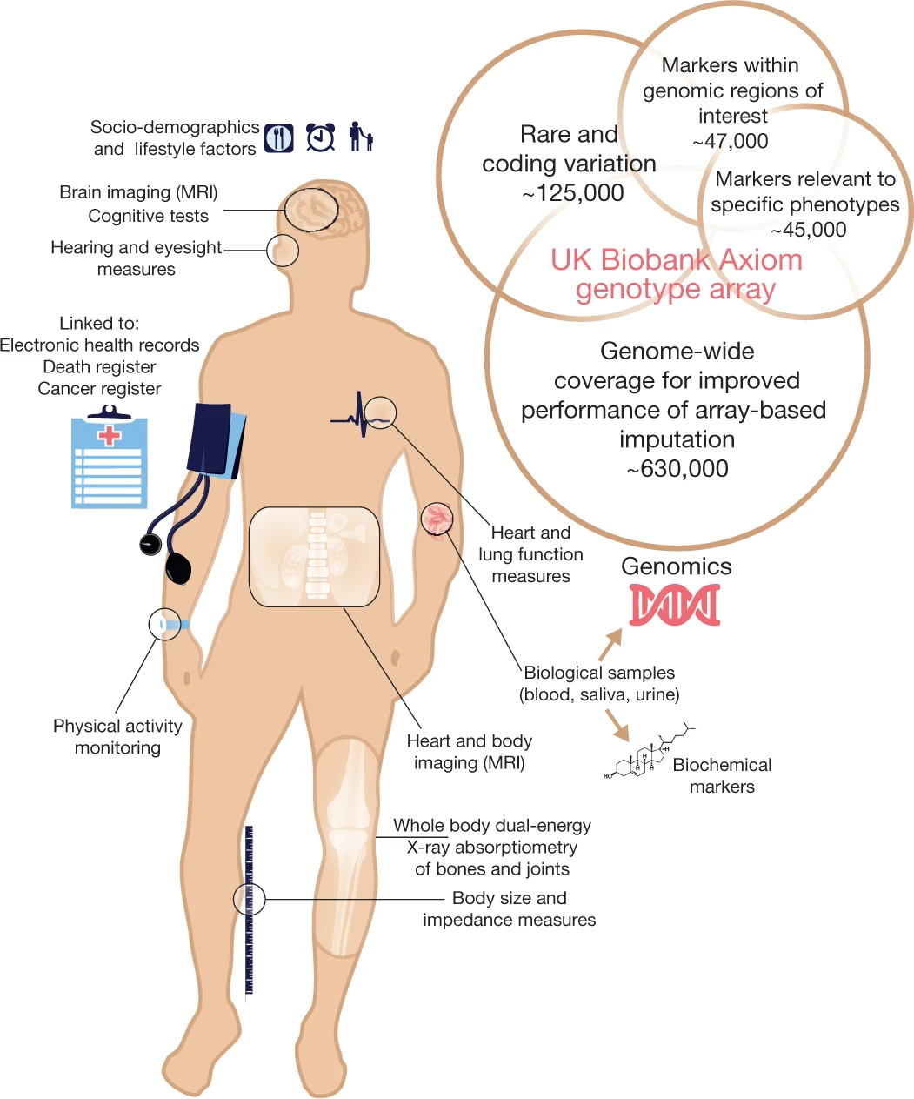
1.1 Image-Tabular Representation Learning
Structured tables are increasingly available in real-world multimodal datasets.
Integrating tabular data is crucial in various applications.
Developing image-tabular representation learning methods is receiving more and more attention.
UK Biobank ^{[1]}
[1] Bycroft, Clare, et al. "The UK Biobank resource with deep phenotyping and genomic data." Nature 562.7726 (2018): 203-209.
Notes:
Structured tables are increasingly available in real-world multimodal datasets.
(click) Integrating tabular data is crucial in various applications, such as marketing and healthcare
A computer-aided diagnosis system should be able to interpret imaging scans with tables to have a complete understanding of patients. This is similar to how clinicians assess patients in hostpitals.
(click) Therefore, Developing image-tabular representation learning methods is receiving more and more attention.

Slide 3
1.2 Current Practices and Challenges
A key challenge is limited labeled data
Prior works proposed self-supervised learning (SSL) + supervised fine-tuning
However, they still suffer significant performance drops when labeled dataset size is reduced
Task-agnostic nature
Overfit during fine-tuning
Notes:
A key challenge for image-tabular learning is limited labeled data, especially for classifying rare diseases
(click) Prior works proposed to first conduct self-supervised pre-training on large-scale unlabeled data, and then perform supervised fine-tuning on a few labeled data
(click) However, they still suffer significant performance drops when labeled dataset size is reduced, which is mainly due to two reasons
(click) First, pre-training on unlabeled data is task-agnostic, which limits the model’s ability to capture information specific to downstream tasks
Second, relying solely on limited labeled data during fine-tuning increases the risk of overfitting and imparis the model’s generalizability

Slide 4
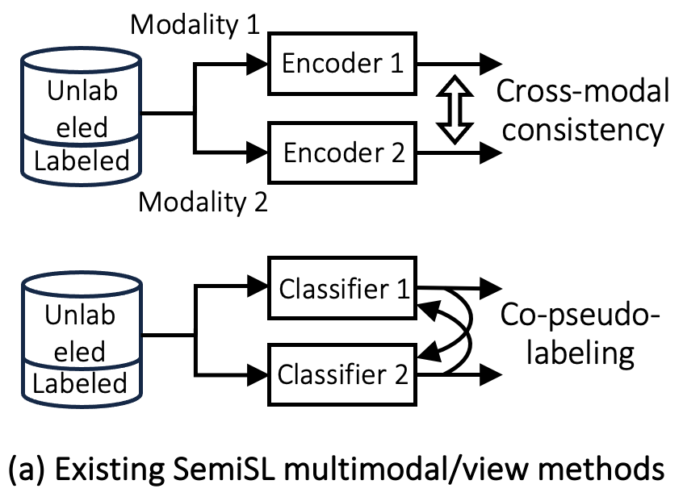
1.2 Current Practices and Challenges
Multimodal semi-supervised learning (SemiSL) is a promising solution
Cross-modal consistency regularization
Co-pseudo-labeling
However, they encounter bottlenecks in capturing task-related information in real-world applications
Focus on modality-shared features
Pseudo-labels generated by unimodal classifiers
Notes:
Semi-supervised learning is a promising direction, which leverages a few labeled data and a large amount of unlabeled data jointly for task-relevant information extraction.
(click) Current multimodal SemiSL can be categorized into two directions.
Cross-modal consistency regularization methods assume that task-relevant information primarily lies in ‘information intersection’ across multiple modalities. Thus, they focus on learning cross-modal invariant (modality-shared) representations from unlabeled data by enforcing consistency constraints across modalities
On the other hand, co-pseudo-labeling methods assume that each individual modality alone can provide enough task-relevant information to train a good classifier. Thus, they use the predictions from classifier 1 to supervise classifier 2.
(click) However, they encounter bottlenecks in capturing task-related information in real-world applications, due to their simplified assumption

Slide 5
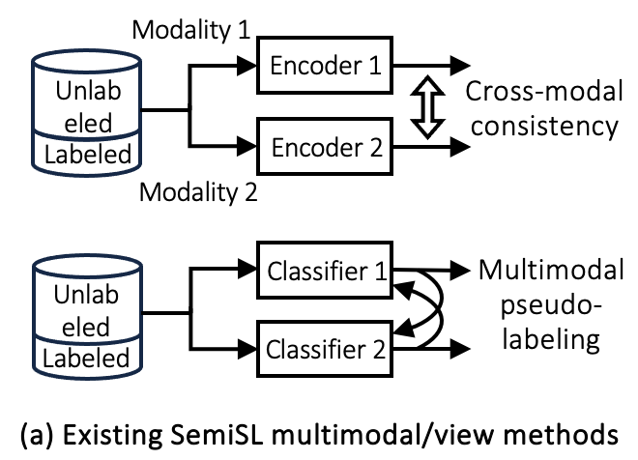
1.2 Current Practices and Challenges
Multimodal semi-supervised learning is a promising direction
Cross-modal consistency regularization
Co-pseudo-labeling
Task-relevant information is contained in both modality-shared and specific characteristics.
Overlook modality-specific features
Generate unreliable pseudo-labels
Modality Information Gap!
Notes:
(click) Take the image-tabular learning as an example. Task-relevant information is contained in both modality-shared and modality-specific characteristics.
(click) In this case, relying solely on modality-shared or unimodal features will cause incomplete task understanding, a limitation we term as Modality Information Gap
(click) Therefore, those cross-modal consistency methods overlook modality-specific features
(click) And in those co-pseudo-labeling methods, the pseudo-labels generated by unimodal classifiers lack full task-relevant knowledge and generate unreliable pseudo-labels.

Slide 6

1.2 Current Practices and Challenges
Multimodal semi-supervised learning is a promising direction
Cross-modal consistency regularization
Co-pseudo-labeling
Task-relevant information is contained in both modality-shared and specific characteristics.
Overlook modality-specific features
Generate unreliable pseudo-labels
How to comprehensively explore task-relevant information in both labeled and unlabeled multimodal data with Modality Information Gap?
Modality Information Gap!

Slide 7
1.3 Our Method -- STiL
We propose STiL, a new semi-supervised tabular-image framework
Disentangled contrastive consistency (DCC): learns modality-shared and specific representations from labeled and unlabeled data.
Consensus-guided pseudo-labeling (CGPL): exploits task-relevant information from unlabeled data
Prototype-guided label smoothing (PGLS): refines the pseudo-label quality

Slide 8
1.4 Contributions
we are the first to investigate SemiSL in image-tabular learning for addressing limited labeled data
Introduce a new DCC module to learn shared and specific information and novel CGPL and PGLS strategies to improve task-relevant information learning
STiL: Semi-supervised Tabular-Image Learning
Identify the Modality Information Gap limitation and propose a new framework for mitigating this gap
STiL significantly outperforms SOTAs, especially when labeled data is scarce
Notes:
In this work,

Slide 9
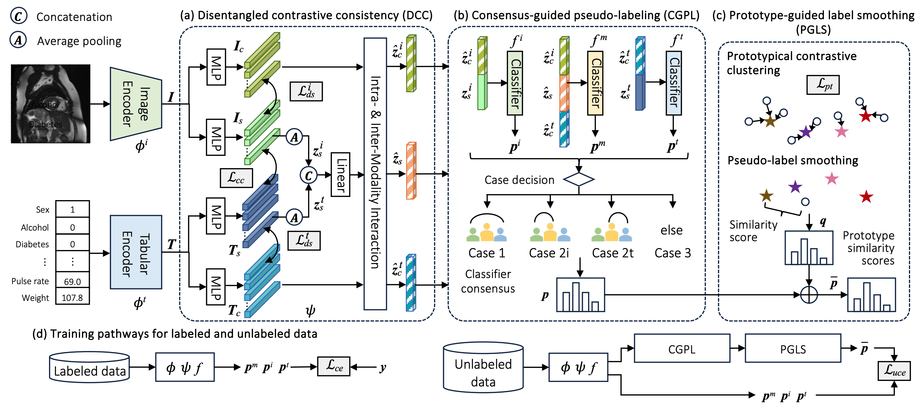
2.1 STiL
Notes:
Similar to prior works, STiL first extracts image and tabular representations through two separate encoders.

Slide 10
2.1 STiL
Disentangled contrastive consistency (DCC): decouples and learns modality-shared and specific representations
Notes:
After that, STiL leverages DCC to decouple and learn modality-shared and specific information from labeled and unlabeled data.

Slide 11
2.1 STiL
Disentangled contrastive consistency (DCC): decouples and learns modality-shared and specific representations
Consensus-guided pseudo-labeling (CGPL): generates pseudo-labels based on classifiers’ consensus collaboration
Notes:
For labeled data, STiL calculates the classification loss using ground-truth. For unlabeled data, STiL leverages CGPL to generate pseudo-labels based on classifiers’ consensus collaboration

Slide 12
2.1 STiL
Disentangled contrastive consistency (DCC): decouples and learns modality-shared and specific representations
Consensus-guided pseudo-labeling (CGPL): generates pseudo-labels based on classifiers’ consensus collaboration
Prototype-guided label-smoothing (PGLS): refines pseudo-labels with prototype similarity scores
Notes:
and refines them with prototype similarity scores in PGLS. These pseudo-labels are used to extract task-relevant information from unlabeled data.

Slide 13
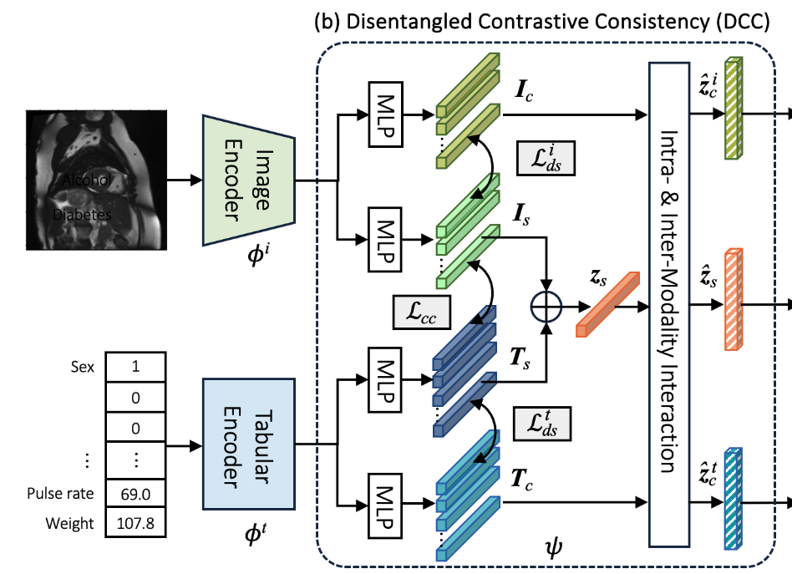
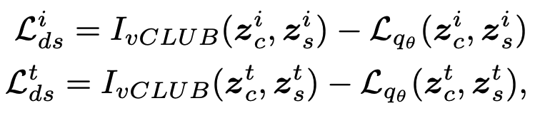
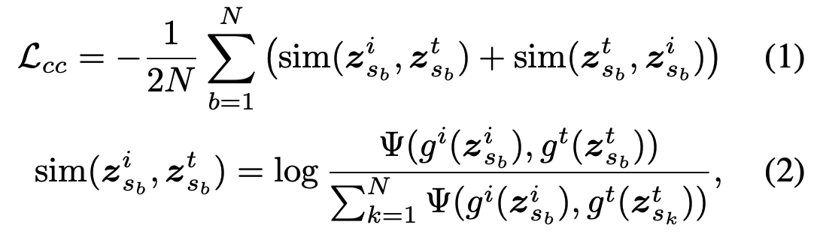
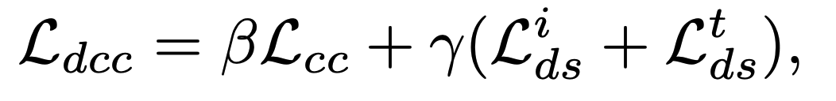
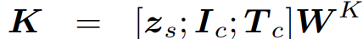
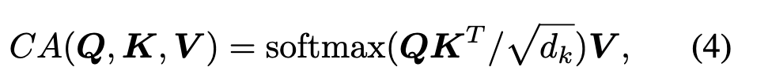
2.2 Disentangled Contrastive Consistency (DCC)
Representation disentangling and consistency
A disentanglement constraint
A shared-information consistency constraint
Intra- & inter-modality interaction
Self-attention: modality-specific representations
Cross-attention: shared and specific representations
Representation disentangling and consistency
Intra- & inter-modality interaction
Notes:
DCC aims to explore comprehensive multimodal representations without relying on ground-truth supervision.
To achieve this, we propose to learn cross-modal invariant representations through consistency constraint while retaining modality-specific representations through disentanglement
For the disentanglement constraint, we maximize the mutual information of the shared and specific representations
(click) The second part is an intra- & inter-modality interaction module, which aims to enhance unimodal and multimodal representation learning.

Slide 14
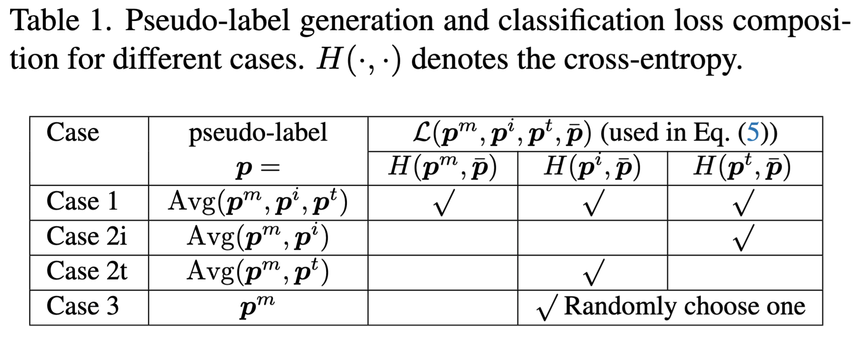
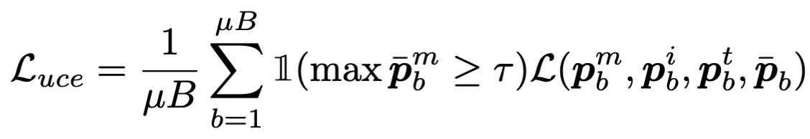
2.3 Consensus-Guided Pseudo-Labeling (CGPL)
Step 1: Consensus classifier collaboration & pseudo-labeling
Case 1: all classifiers agree
Case 2i: f ^{m} and f ^{i} agree
Case 2t: f ^{m} and f ^{t} agree
Case 3: none of the above
Step 2: Selective classifier update
Notes:
DCC leverages unlabeled data in an unsupervised manner. To enable task-relevant information extraction from unlabeled data, we incorporate pseudo-labels in the SemiSL process.
Therefore, we propose a rule-based strategy for reliable pseudo-labeling, which uses the alignment between the multimodal classifier and unimodal classifiers.
As we utilize classifier consensus during training, there might be a situation that all classifiers agree on an incorrect class. To avoid this classifier collusion, we propose a selective classifier update to allow classifier diversity.

Slide 15
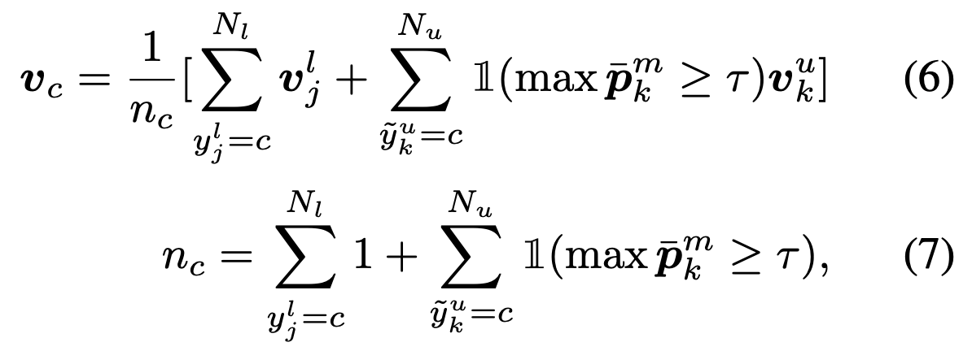
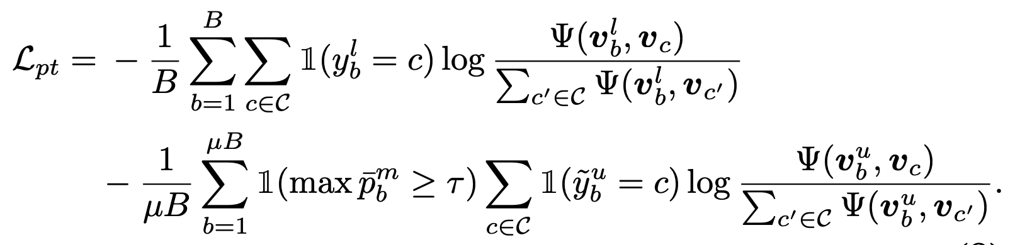
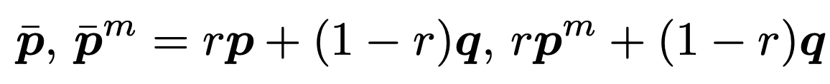
2.4 Prototype-Guided Label Smoothing (PGLS)
Step 1: Class prototype extraction
Step 2: Prototype contrastive clustering
Step 3: Pseudo-label smoothing
Overall loss
Labeled cross-entropy loss
DCC loss
PGLS loss
Unlabeled cross-entropy loss
Notes:
In this module, we utilize feature-level label information to refine pseudo-labels

Slide 16
3.1 Datasets and Metrics
UK Biobank (UKBB)
Two binary classification tasks: myocardial infarction (Infarction) vs. health, coronary artery disease (CAD) vs. health
2D MRI cardiac image and 76 tabular features (49 continuous, 26 categorical)
36,167 samples (3,482 CAD train | 1,552 Infarction train, 6,510 val, 3,617 test)
Metric: AUC
Data Visual Marketing (DVM)
Multi-class classification task: car model prediction
2D RGB image and 17 tabular features (11 continuous, 4 categorical)
176,414 samples (70,565 train, 17,642 val, 88,207 test)
Metric: Accuracy
Notes:
We study a medical dataset for CAD and infarction classification, a natural image dataset for car model prediction

Slide 17
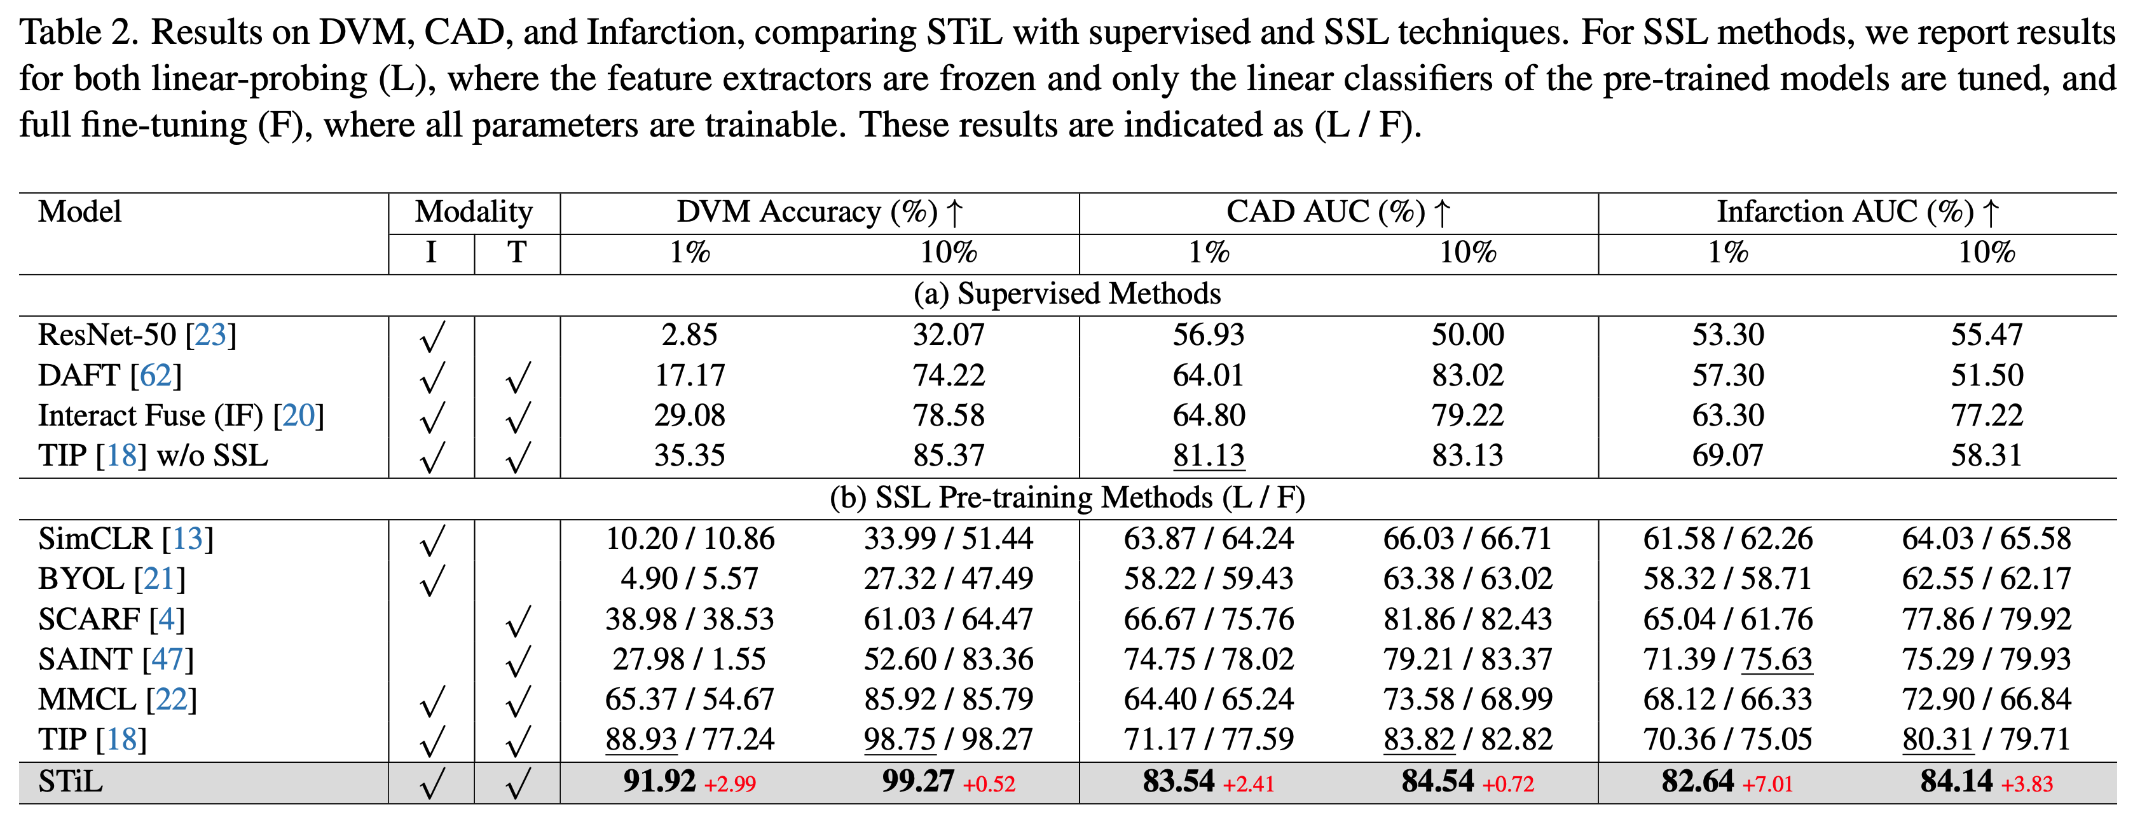
3.2 Comparing Against Existing SOTAs
Comparing against supervised/SSL SOTAs
Multimodal methods generally outperform unimodal methods
SSL methods have improved performance in low-data settings but still suffer from overfitting
STiL mitigates overfitting and achieve the best performance (7.01↑ AUC on 1% labeled Infarction)

Slide 18
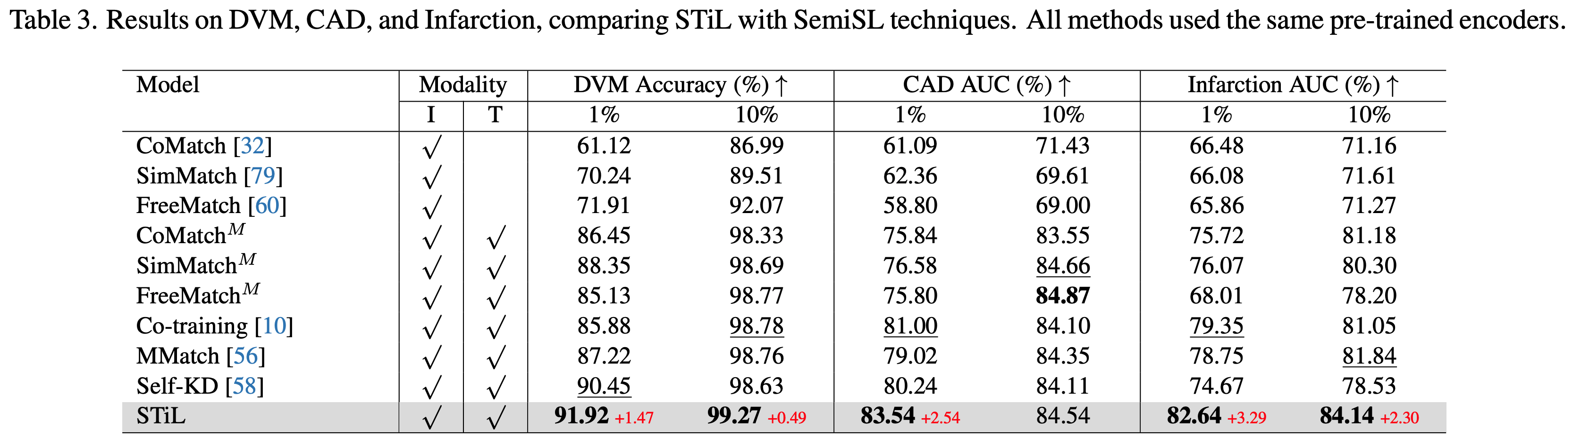
3.2 Comparing Against Existing SOTAs
Comparing against SemiSL SOTAs
Adapting SemiSL image approaches to multimodal settings improve their performance, but they still lag behind methods tailored for multimodal tasks
Prior SemiSL methods do not consider the Modality Information Gap in multimodal tasks
STiL mitigates the gap and achieves the best performance (3.29↑ AUC on 1% labeled Infarction)

Slide 19
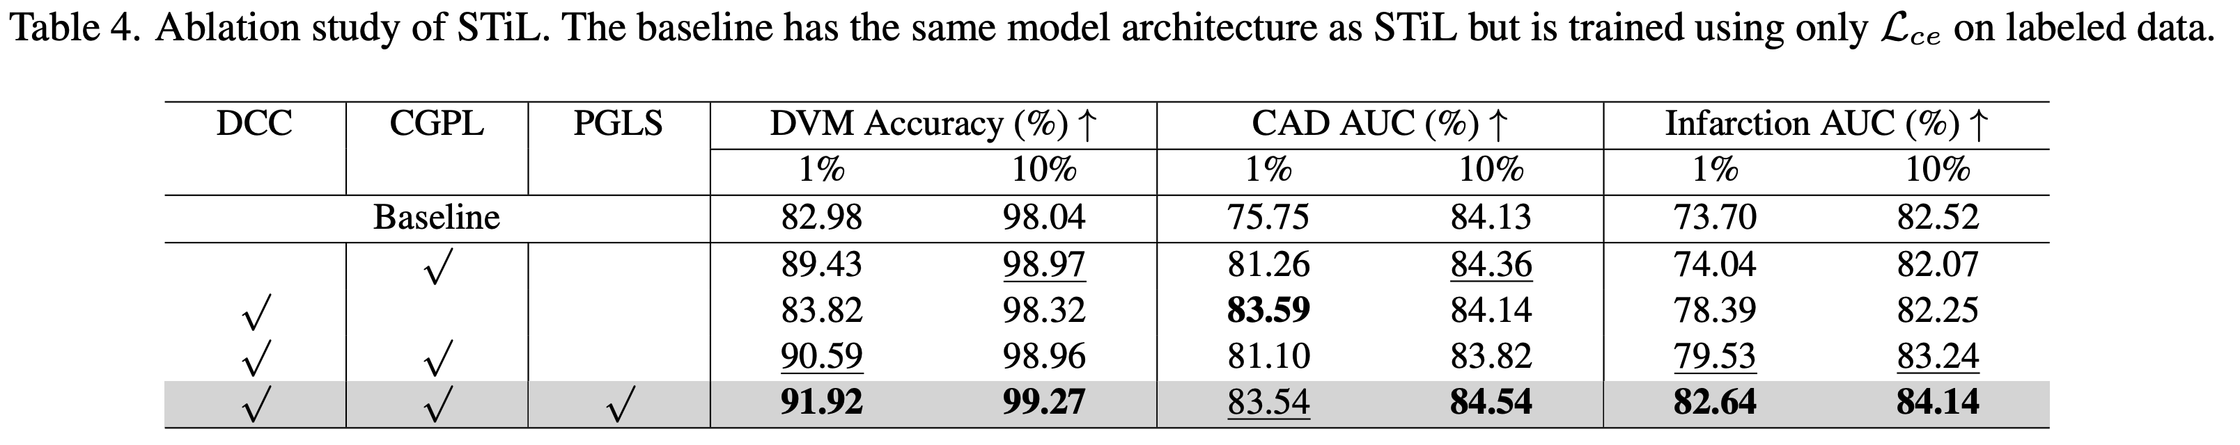
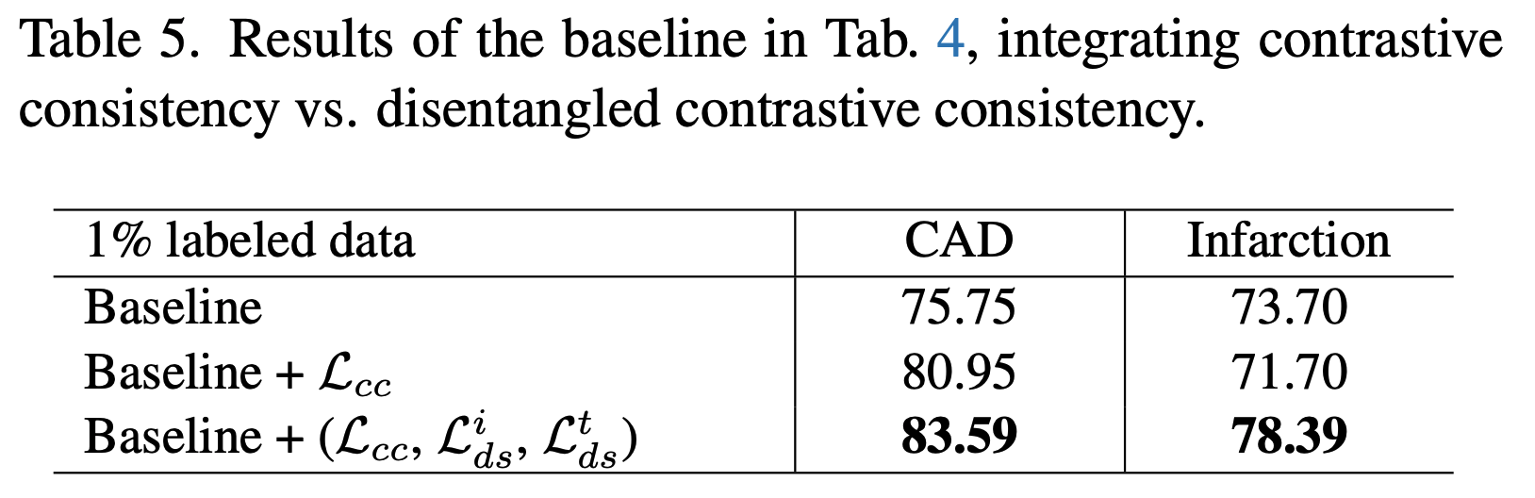
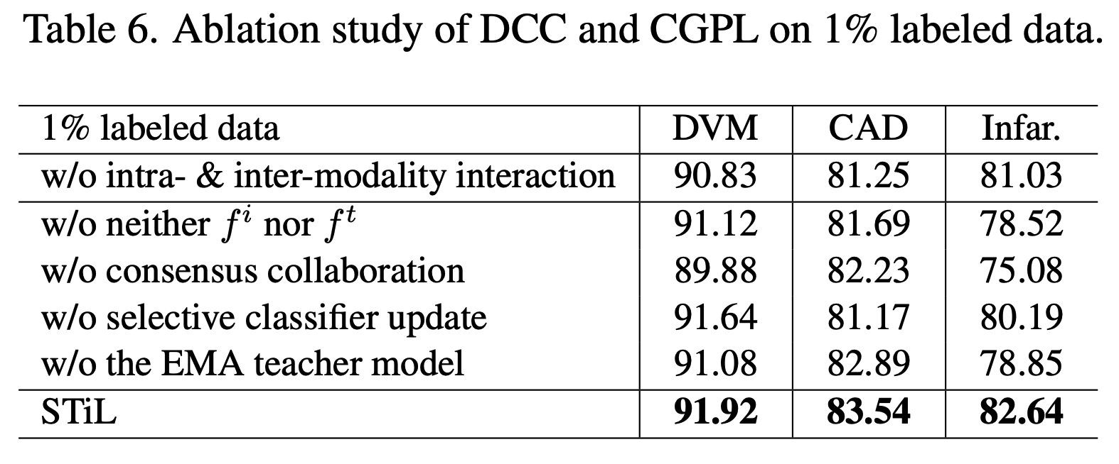
3.3 Ablation Studies
Efficacy of Key Model Components
Ablation Study on DCC
Disentanglement losses
Intra- and inter-modality interaction

Slide 20
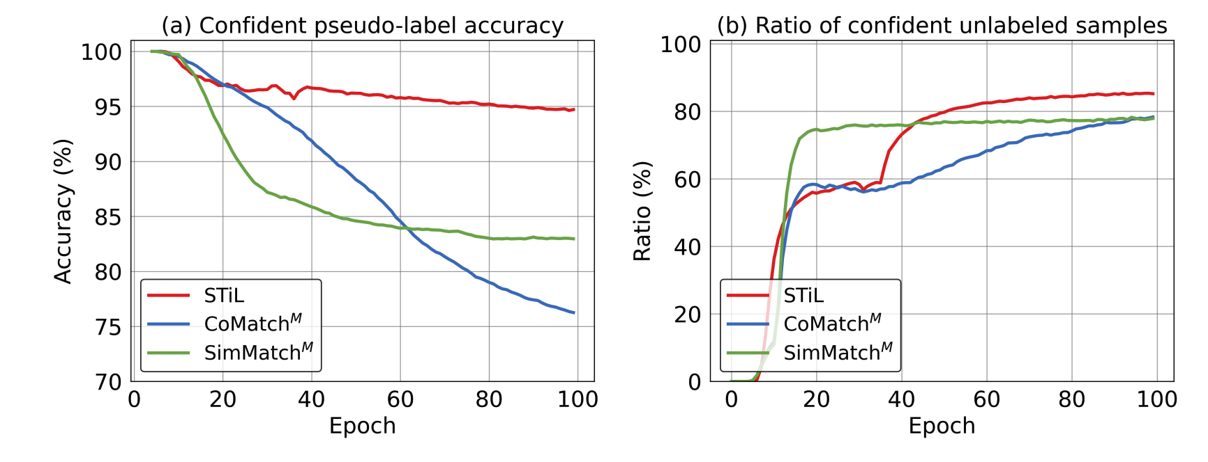
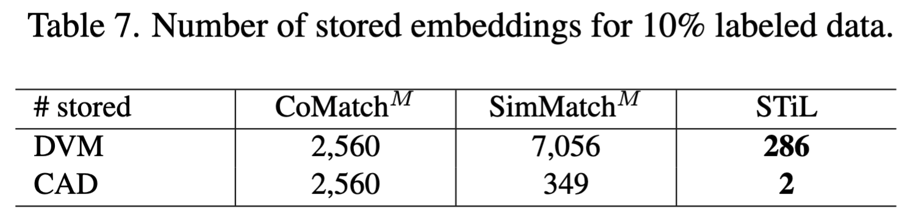
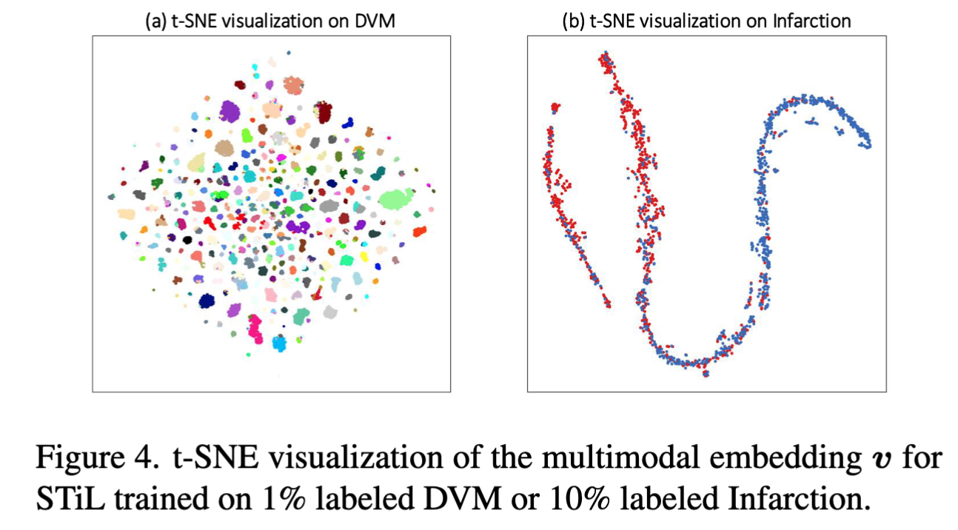
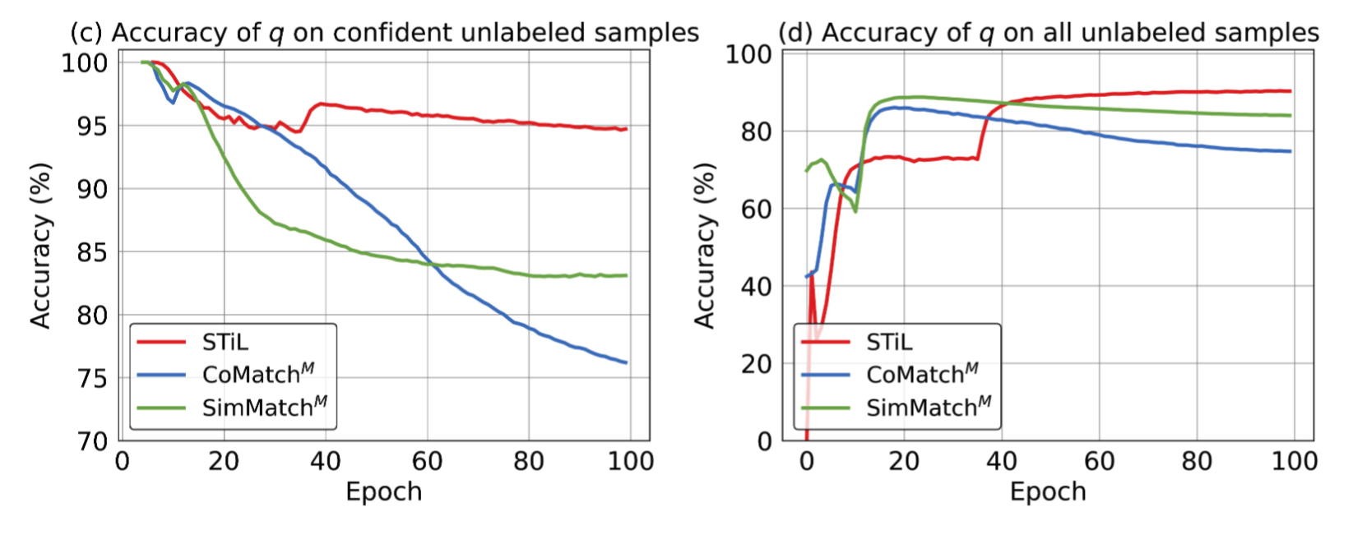
3.3 Ablation Studies
Ablation study on CGPL
Efficiency and efficacy of PGLS

Slide 21
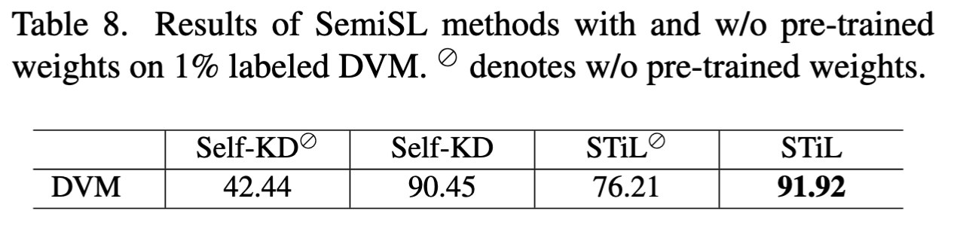
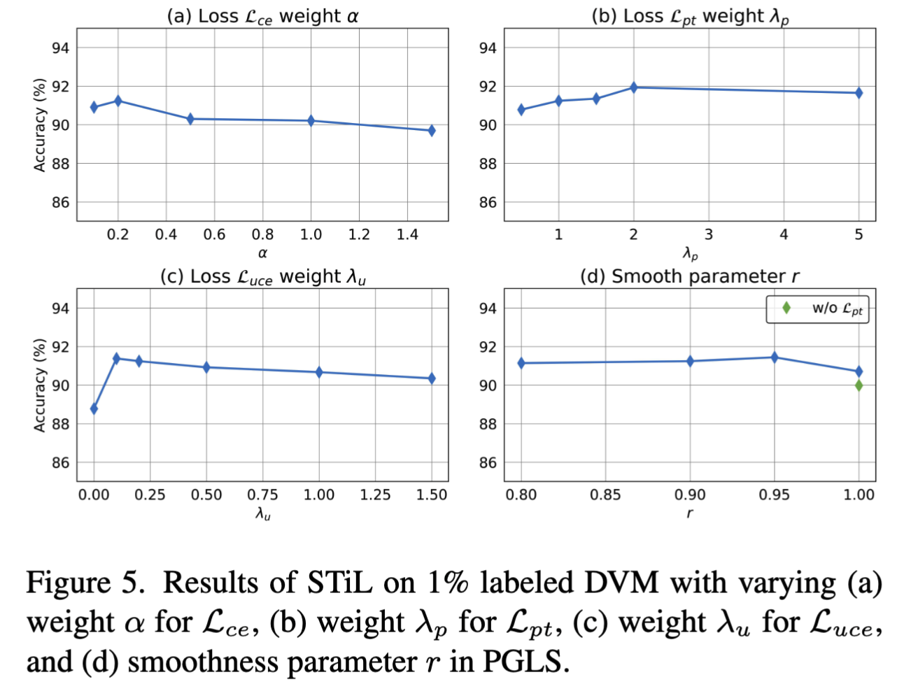
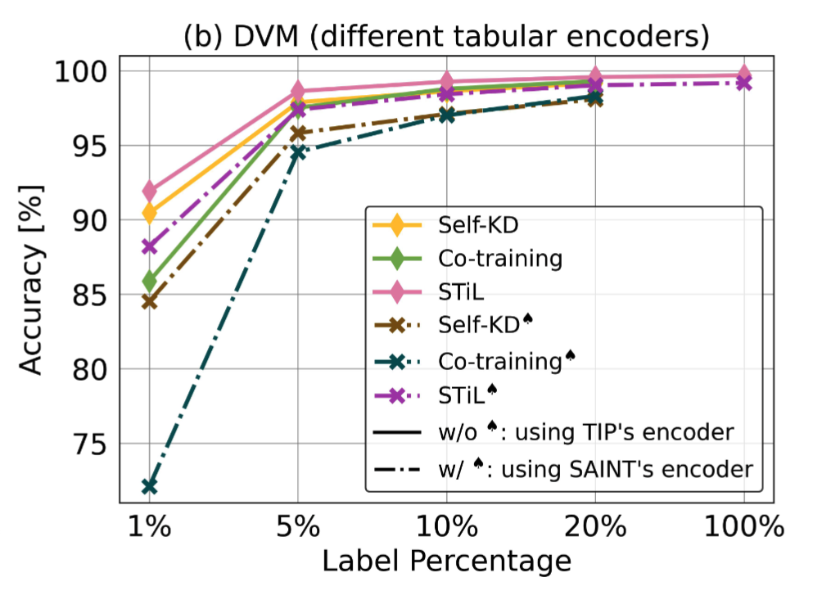
3.3 Ablation Studies
Impact of pre-trained weights
Sensitivity analysis
Applicability to different tabular encoders

Slide 22
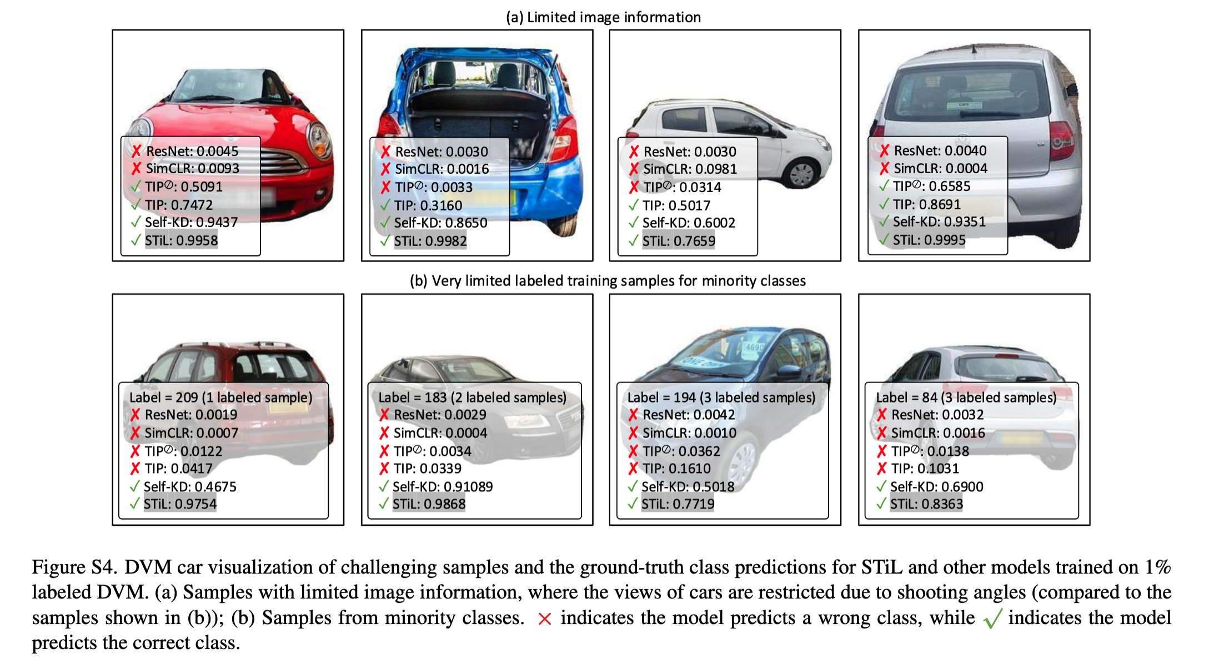
3.4 Visualization
Case study

Slide 23
Conclusion
We identified the Modality Information Gap limitation and presented the first exploration of SemiSL for the image-tabular domain
We proposed STiL, a novel SemiSL framework, featuring a novel disentangled contrastive consistency module, along with consensus-guided pseudo-labeling and prototype-guided label smoothing strategies
Experiments on natural and medical image datasets have demonstrated STiL’s superior performance
We also observed that
Integrating tabular data can improve the image model performance
SemiSL methos are better solutions than SSL/supervised methods for limited labeled data
The Modality Information Gap exists in multimodal tasks

Slide 24
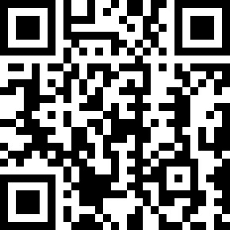
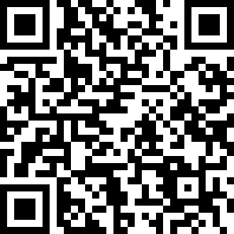
STiL: Semi-supervised Tabular-Image Learning for Comprehensive Task-Relevant Information Exploration in Multimodal Classification
Paper is available at
Code is available at
Thank you!
Contact us: {s.du23, x.luo, declan.oregan, c.qin15}@imperial.ac.uk
Notes:
That's all. Thank you for your listening.

Slide 25
Backup

Slide 26
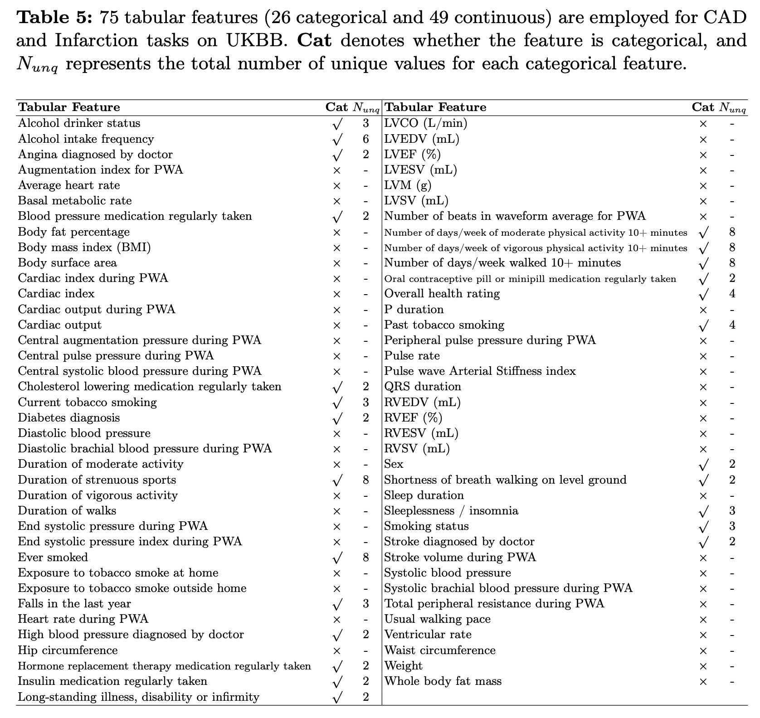
Data
ID | Acro | Name
1 | LVCO
2 | LVEDV | LV end-diastolic volume
3 | LVEF | LV ejection fraction
4 | LVESV | LV end-systrolic volume
5 | LVM | LV myocardial mass
6 | LVSV | LV stroke volume
7 | RVEDV | RV end-diastolic volume
8 | RVEF | RV ejection fraction
9 | RVESV | LV end-systolic volume
10 | RVSV | RV stroke volume

Slide 27
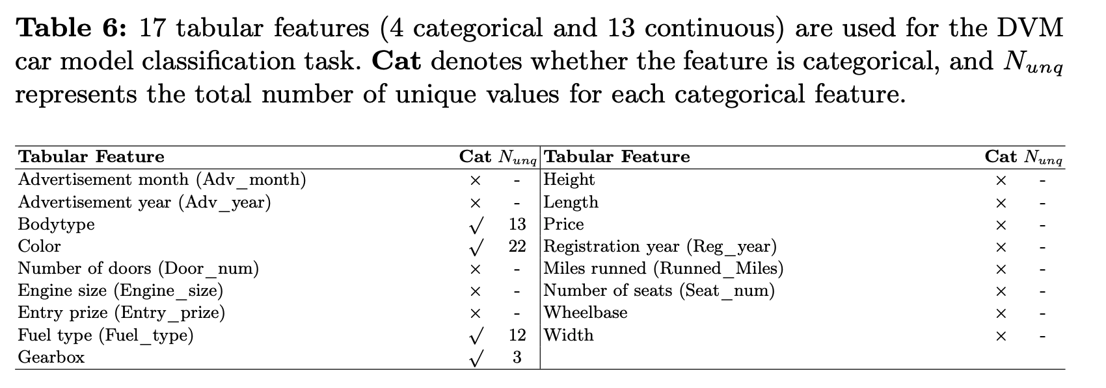
Data

Slide 28
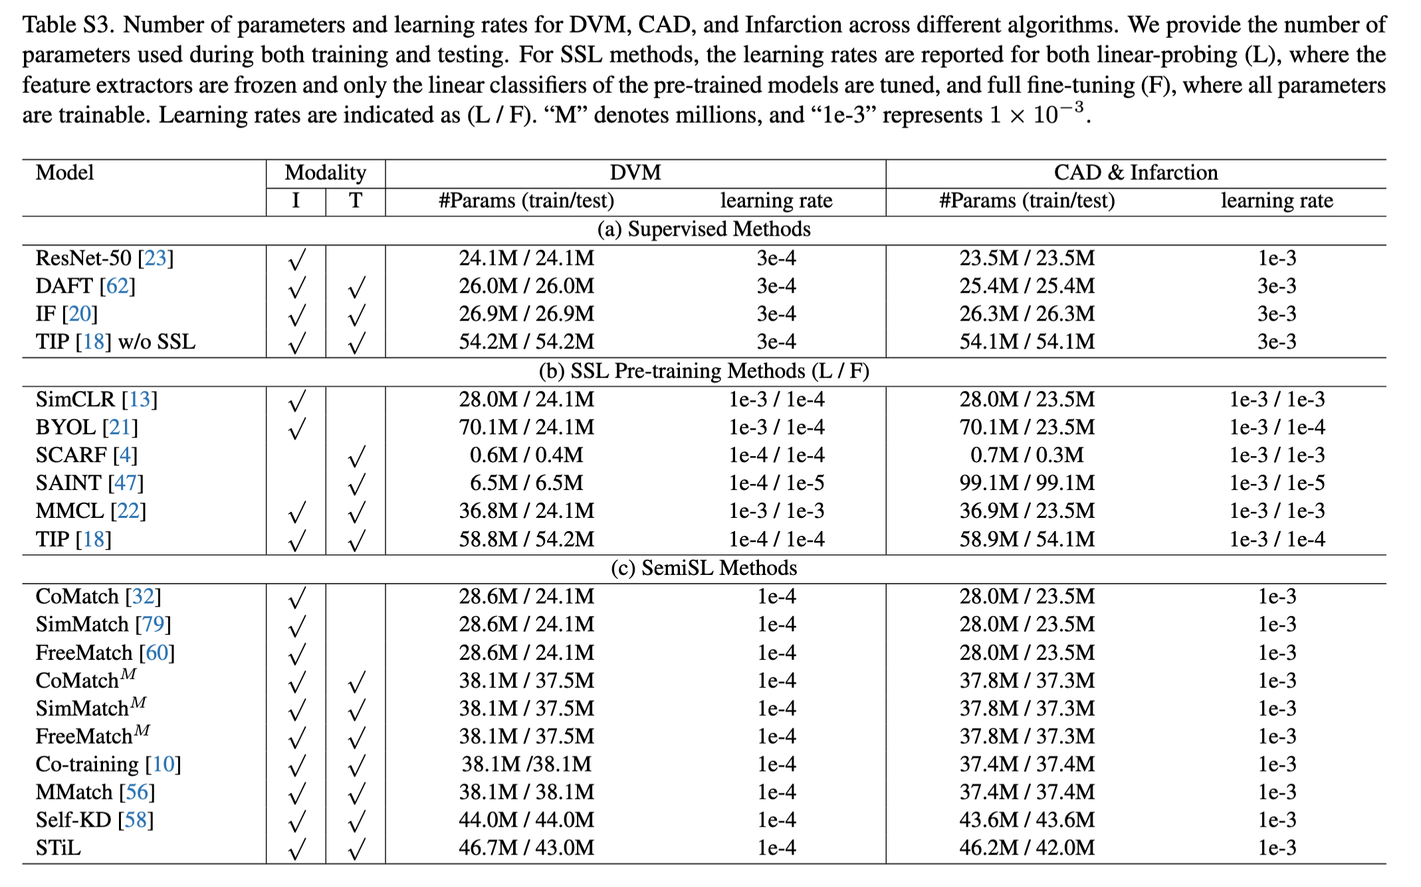
Number of Parameters

Slide 29
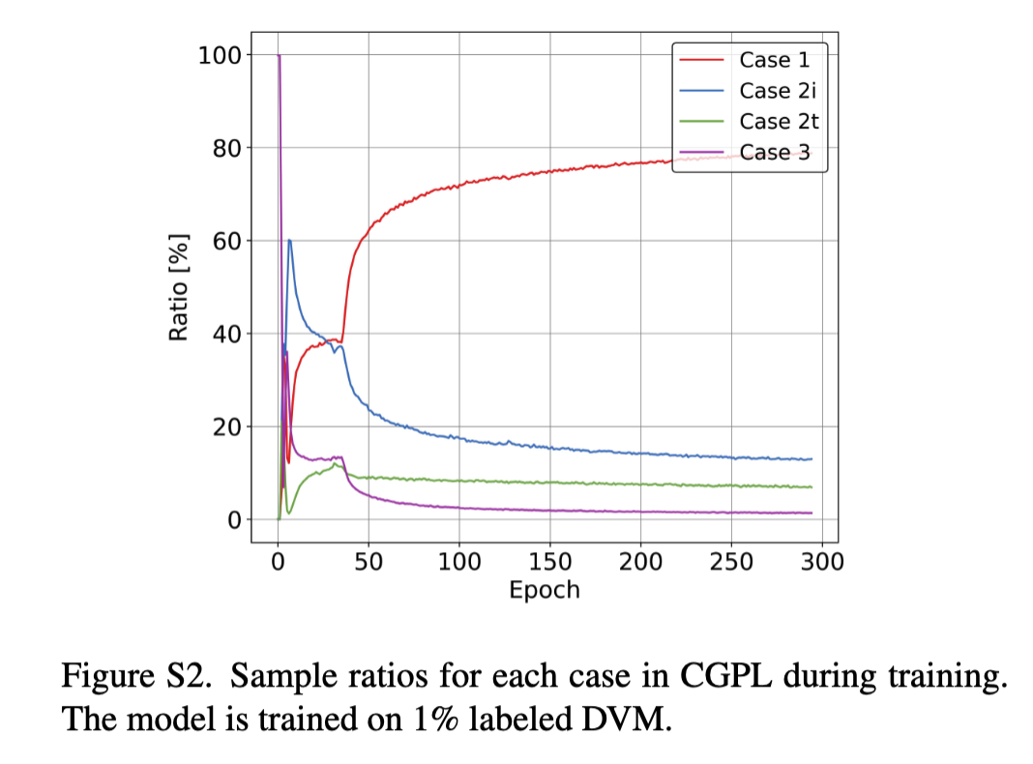
Sample Ratios for Different Cases in CGPL

Slide 30
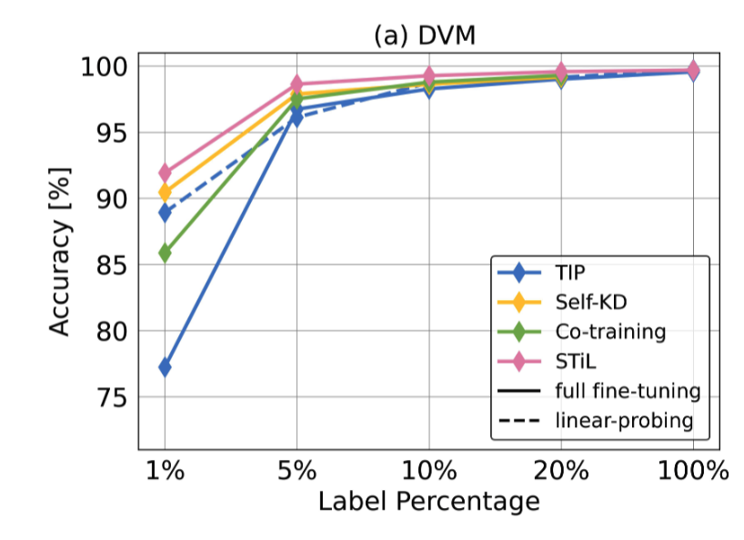
Experiments with a Finer Grid of Label Percenta

Slide 31
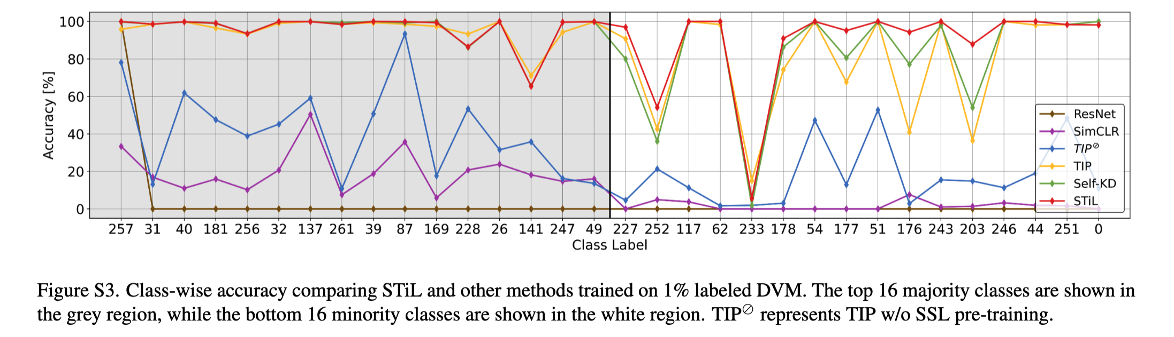
Class-wise Accuracy in DVM

